Slide 1
How do you control Algal Blooms?
What is limiting to algal growth?
  Remember Liebig’s Law of the Minimum
1960-1970’s
  No or little regulations
  No scientific data, but suspicions were growing
Notes:
Nutrients are bad – have increased considerably…
Pretend you are back in the 1970s – when a lot of this was first known, or came about…
Detergents accounted for 50% of p worldwide
1 lb P can grow 700 lbs algae!
Lake eerie ages 15000 years in 50 years (sped up!).
1960s things were getting bad
Detergent companies – proctor and gamble, lever brothers, colgate-palmolive (80%). Coopoeratieve at first..find something else because of public concern. Used a NTA – cancerous.
1970s reduce P to 8.7% volunteerily. Did not want it banned until they could find an alternative.
1969 – congress

Slide 2
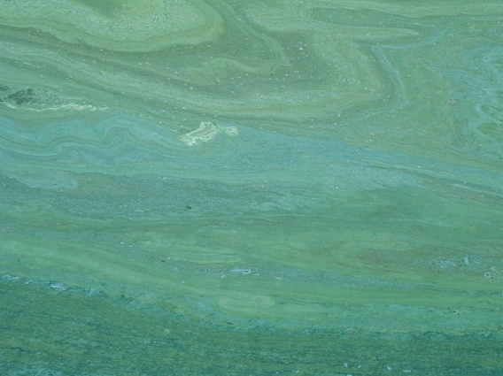
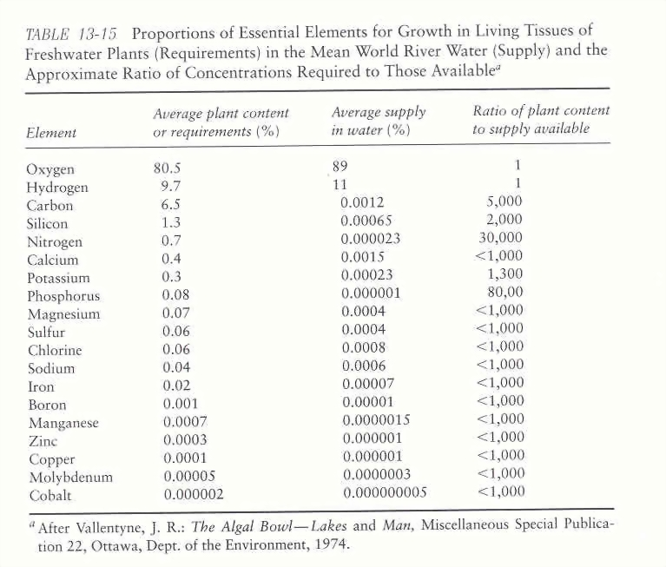
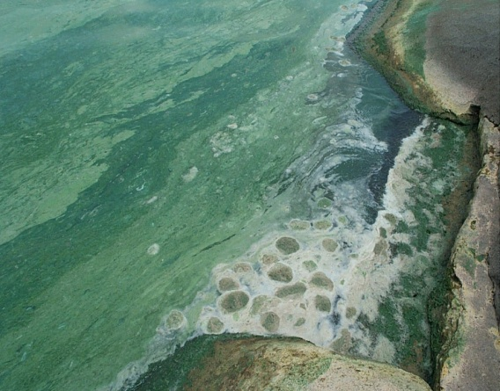
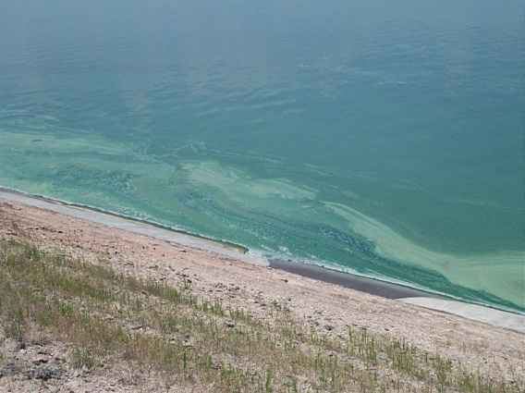
What do we (they) know…
0
0
Notes:
They knew that this was happening…they new what plants needed – they can see what is out there, and look at these ratios.
Lots of phosphorus in sewage – see later = not treated!
Where was P – laundry detergent
What do you do? How can you do this – scientific way, primary literature…

Slide 3
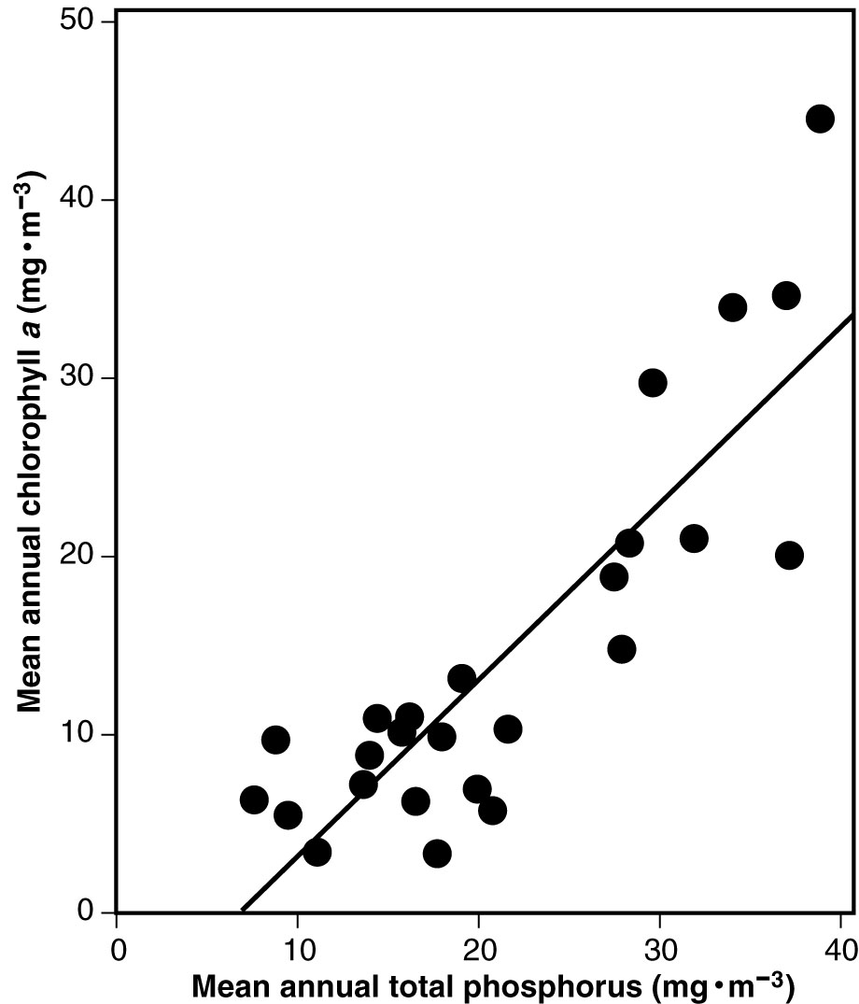
PHOSPHATE AS A LIMITING NUTRIENT
Notes:
Strong relationships between P and algal production. This suggests that P is often limiting to freshwater systems.
These patterns exist throughout the world. More nutrients = more chlorophyll a

Slide 4
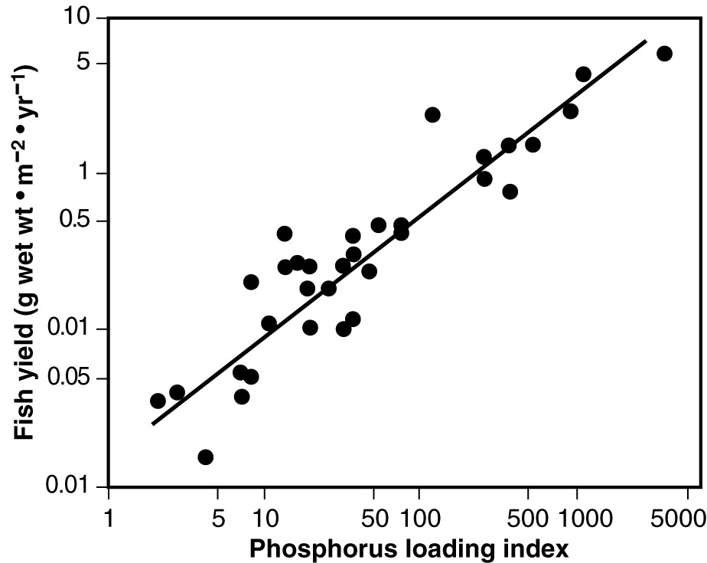
A benefit of cultural eutrophication.
Notes:
However…this can also be done on purpose – more algae, more food for zooplankton (remember the grazers of the earth) – more fish…with a lot of environmental issues, not everyone is on the same playing field…

Slide 5
Where was P coming from
Laundry detergents and P (1960-70)
  7-12% P by dry weight
  50-70% of P input to lakes from detergent
  Accounted for ~50% of the wastewater worldwide
  Public interest peaking…
  Industry digging heals in… “no direct link between P and algal growth”
How do you make this link?
Notes:
Again, we are still back in the 70’s….
What else has a lot of P in it still?
What would you do? Where do you make this link? Through what media or vehicle or mechanism?
Phosphorus used in detergents – helps with the cleaning process
1959 to 1969 – all laundry detergent 7-17% P
2 million tons of P annually

Slide 6
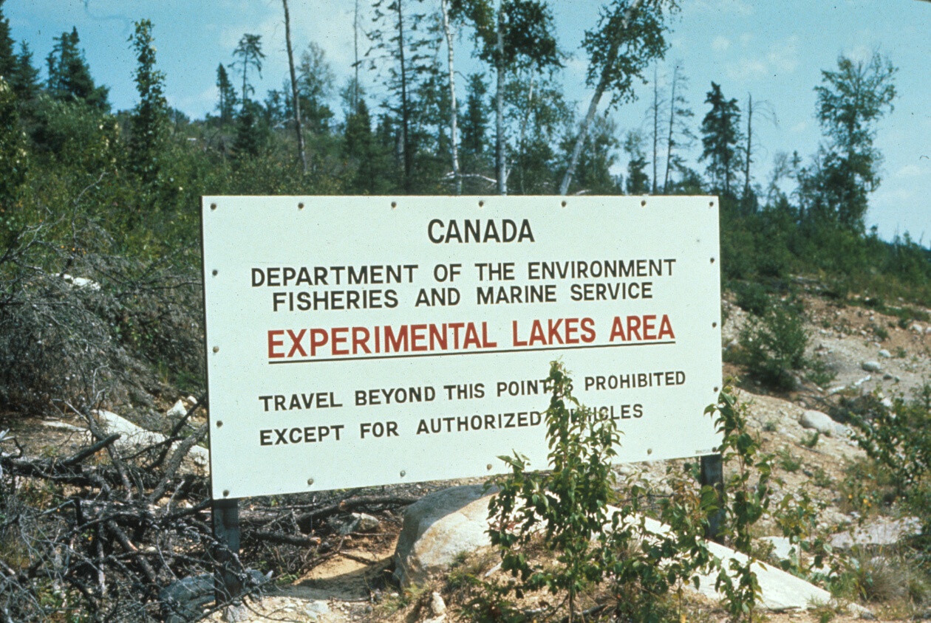
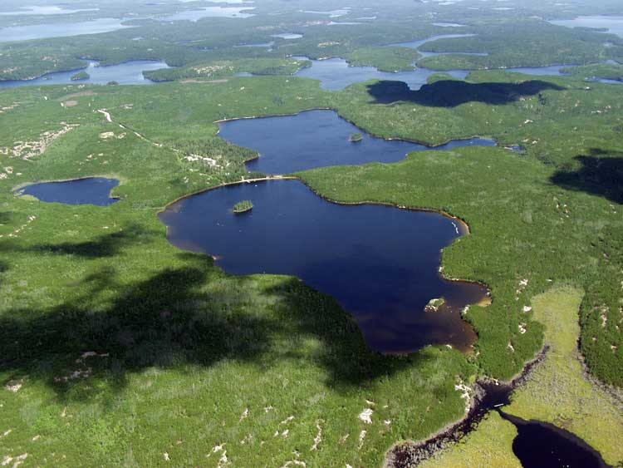
Is Phosphorus limiting to freshwater systems?
David Schindler conducted experiments in the Experimental Lakes Area (ELA) of Canada
Notes:
Is phosphorus limiting?
EXPERIMENTAL LAKE AREA
SW ONTARIO
DAVID SCHINDLER – very famous limnologist – had the opportunity to conduct research using whole lake studies
Never been exposed to contaminants – oligotrophic systems…

Slide 7
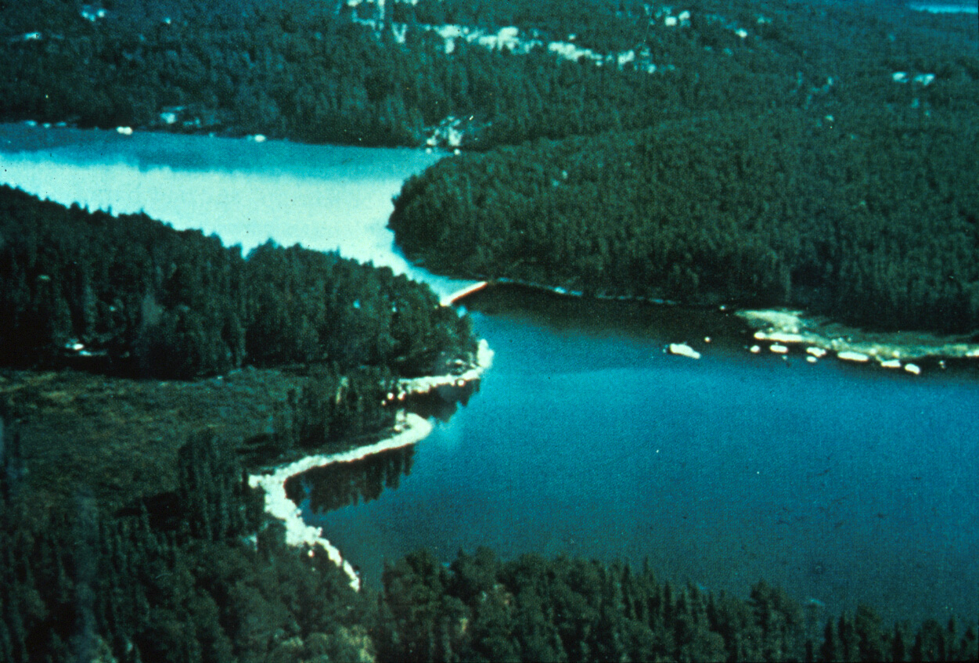
Experiment in Lake 226
C + N + P
added
Sea curtain
C + N
added
Notes:
Classic example…

Slide 8
Additional Experiments at ELA
Experiment in Lake 304
  Monitored lake without nutrient addition, added C, N & P, and then added only C & N
  Can lakes recover from Eutrophication?
Notes:
Took it a step further – can lakes recover from eutrophication? Lake 304. Added nutrients and then stopped to see if it could recover…

Slide 9
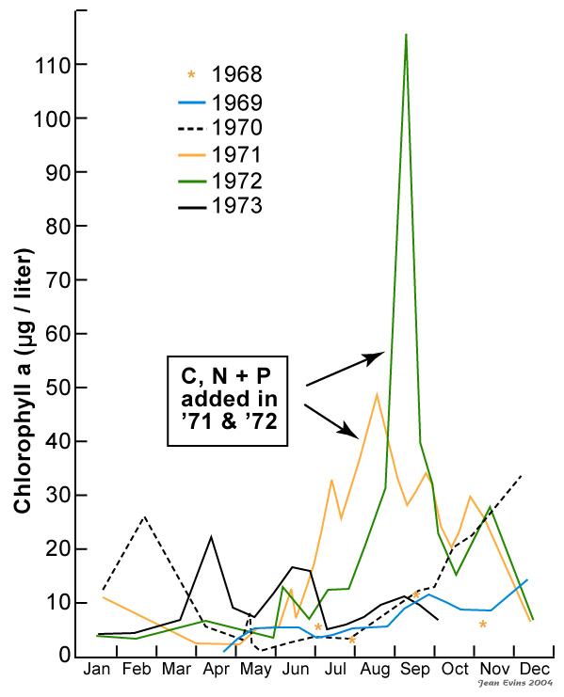
Experiments at ELA
Experiment in 304
Yes, eutrophic lakes would recover if phosphorus stopped being added!
Notes:
Yes indeed, they did recover. This is also very important

Slide 10
Conclusions
Phosphorus limits algal production.
Reducing phosphorus input into most lakes could result in abatement of eutrophication.
Ban on detergent phosphorus would be more effective than plans to remove phosphorus at the sewage treatment plant.
Notes:
This was very important for the regulation of P in detergents.

Slide 11
Paradigm: P limits algal production in freshwater systems
Notes:
Lead to what we call a paradigm? What does that mean? Define distinct concepts or an over arching view of nature
Whole lake studies…what else can you do? Taking water and adding nutrients…
Oceans = n limited…

Slide 12
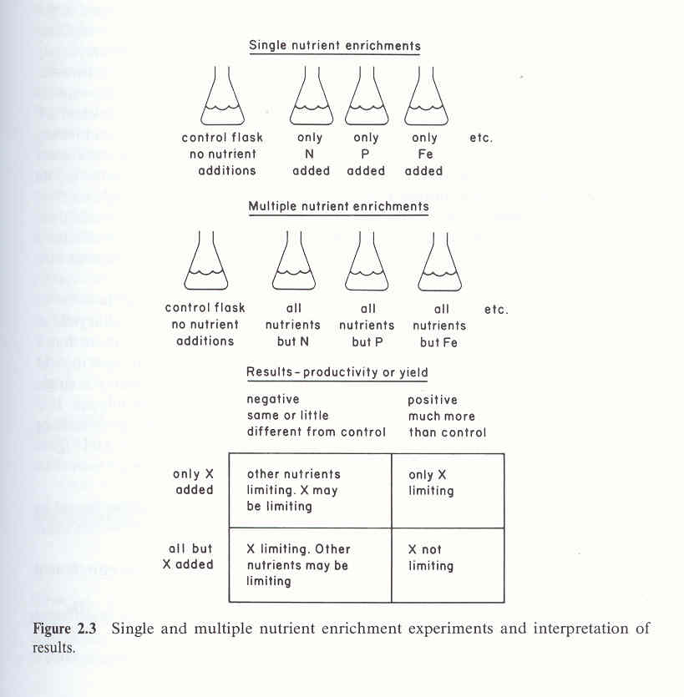
Assessing Nutrient Limitation: Bioassay Experiments

Slide 13
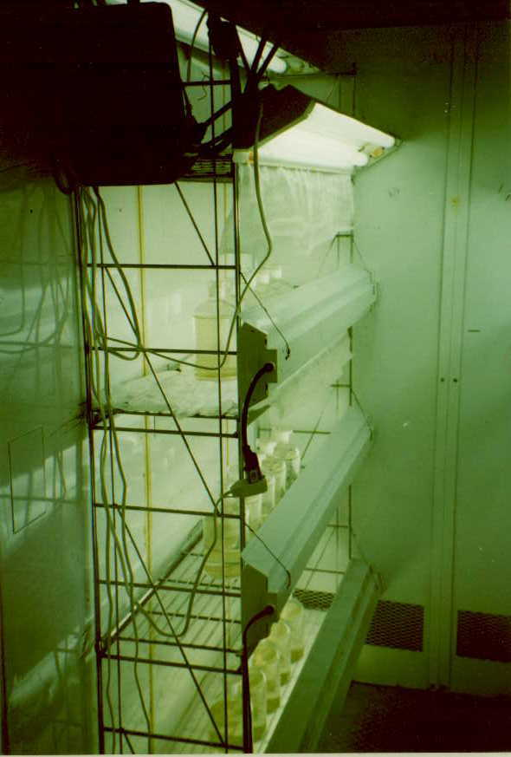
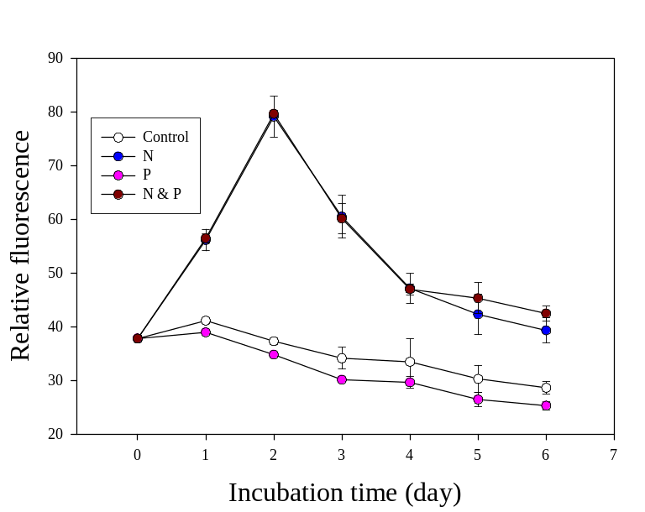
Notes:
Can also do these in situ – some potential problems with doing these in the lab in bottles. What might be bad about this?

Slide 14
Scientist are trying to determine which best management practices will reduce the eutrophication of a lake. Water samples were collected and the following data was obtained for chlorophyll a concentrations (ug/L).
 | No Nitrogen Added | 1000 ug /L Nitrogen Added
No Phosphorous Added | 15 | 30
100 ug/L phosphate added | 17 | 45
Notes:
Averages – would actually have replicates right?
Control (no nutrients added)

Slide 15
Elser et al. (2007) – Meta-analysis
Literature search (e.g. Web of Science)
  Keywords (e.g. nitrogen, phosphorus, etc.)
  Response ratio – RRx = ln (E/C)
  Studies:
    653 freshwater
    243 Marine
    173 Terrestrial
Notes:
Elser et al. (2007) Conducted literature search to find experiments examining P and N effects on production of natural algal communities – meta-analysis…
What was their goal? How did they do it?
E measured value of response variable = what was the response variable that they measured?
For x enrichment…
C = control
Why do this?

Slide 16
Elser’s Conclusions
N and P limitation strong and widespread
N and P co-limitation = higher responses than single nutrient treatments
  Synergistic effects
Balanced approach to P and N abatement!
Notes:
Look at these stressors, we will see that the effects can vary depending on whether other stressors are present…tie some of these stressors together at the end of the semester…
What does he come up with as a reason? Why is N so much more important than originally thought?

Slide 17
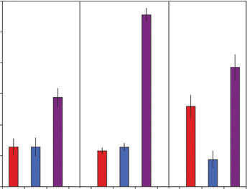
Elser et al. (2007)
Terrestrial
Freshwater
Marine
+N
+P
+NP
+N
+P
+NP
+N
+P
+NP
Notes:
How determine this? Standardized effect – compare how much change in biomass was seen relative to controls = percentage so that it can be standardized across studies.
N and P strong and widespread;

Slide 18
What is going on with N?
Much more complex cycle than P
  Gases form
    Humans can add to ecosystems through many pathways

Slide 19
Stoichiometry
Ecological stoichiometry is the study of the balance of ratios of elements in an organism and its environment
TN:TP
Redfield Ratio (106:16:1 – C:N:P) or (16:1 – N:P)
  Lower ratios = N limited
  Higher ratios = P limited
Notes:
Often think of this in the terms of N:P, as we have talked about the most important nutrients in aquatic ecosystems.
Redfield ratio = ratio of CNP in marine algae; relatively stable did not vary; Thought that if the nutrients in the system were different then there would be an imbalance and growth would suffer. Depending on the differences you can predict nutrient limitation.
If more nitrogen this ratio will go up and then the system would be imbalanced and the system would be p limited
If more phosphorus the ratio in the water would be lower and this would indicate that there is nitrogen limitation.
Anything different than 16:1= limitation
More nitrogen and this goes up = higher ratios indicate P limitiation
More P and this goes down = n limitation
Been well studied; this has been found to be hold true in a lot of systems. 16:1 are not the numbers that they use now though/ based on marine, different species have different ratios.
Maybe we have

Slide 20
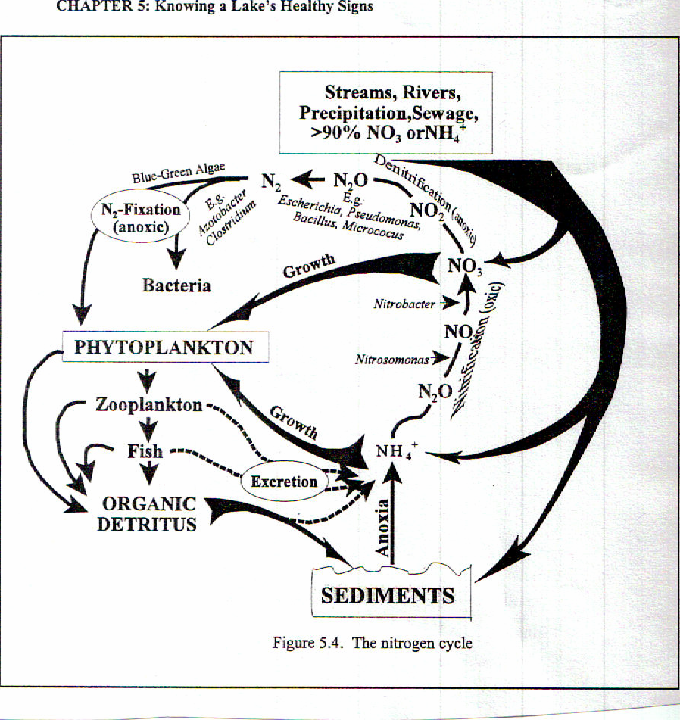
Major Processes:
N-fixation
Ammonification
Nitrification
Denitrification
Notes:
This is the cycle; much more complex than P
N₂→organic N
Ammonium (NH₄) production through decomposition of organic matter
Nitrification - Ammonium to Nitrate
Loss of nitrogen from a system unless it is fixed again

Slide 21
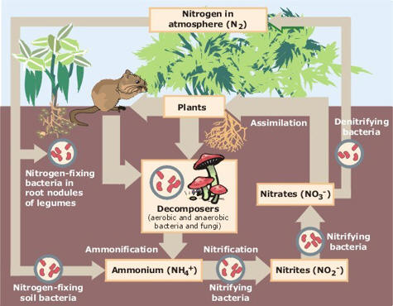
Notes:
Much more complex – several processes that are important…

Slide 22
Cyanobacteria actually do well under N-limiting conditions (e.g. low TN:TP ratios)
WHY?
Notes:
Cyanobacteria do well when there is a lot of P - does not mean that there is not a lot of N, but there is not a lot of N relative to P!

Slide 23
Nitrogen fixation
N₂→organic N
Bacteria (cyanobacteria & heterotrophic forms)
Nitrogenase
  Anoxic
Light dependent
Anaerobic organisms
Aerobic organisms
  Heterocyst
Notes:
Molecular nitrogen is not usable by aquatic plants unless it is converted to a different form. Conversion to organic form – used by the organism that is converting it! However, very few organisms are able to do this conversion. Not received a considerable amount of attention (last 2-3 decades). Can be a significant source! hose that can are called nitrogen fixers – transformation of N2– this is why it is often considered an autochthonous source – internal mechanisms make it available to organisms. (if you just considered where it came from, and not its usability, them you might consider it allochthonous source.)
Different types of bacteria are responsible for this – talk more about this later
Mainly cyanobacteria – strong correlations between cyanobacteria and nitrogen fixation in open waters.
There is an enzyme that is responsible for this reaction – nitrogenae using ATP as energy source. Produces ammounium which is converted to ammo acids and sent to cells for protein synthesis. Bring the N2 in and convert it to a type that allows them to grow. Can not function in the presence of oxygen – How do they deal with this? Live in anearobic environments. Get the energy to do this through light! Just like a lot of things that we will talk about, it can be inhibited at the surface because light it too much.
When there is oxygen – heterocyst which is a specialized cell that creates an anoxic environment – this is where N fixatio noccurs. (in anaerobic do not need this – but have developed evolved this mechanisms for doing this when oxygen is available.
Keeps other gases out!
As we will see, N fixation can be important depending on conditions – including how much N is available already in usable form. Remember this takes energy to do – only do it if you have to.
Iron and molybedum – more of these elements = more fixation

Slide 24
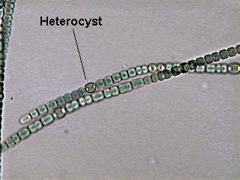

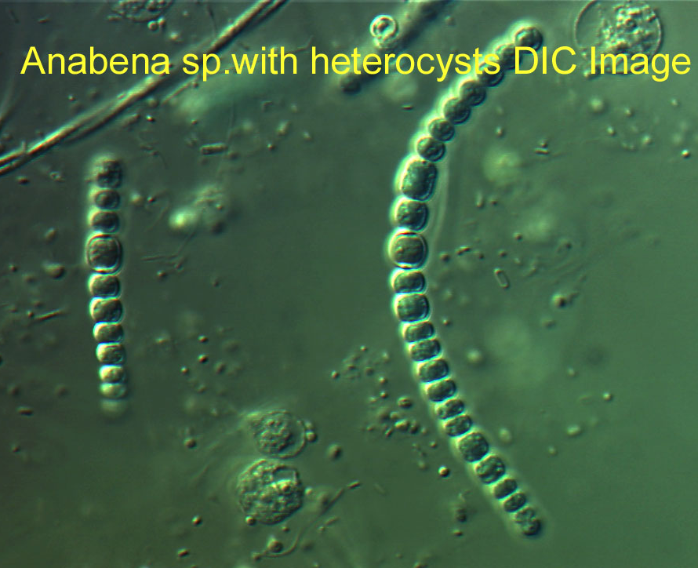
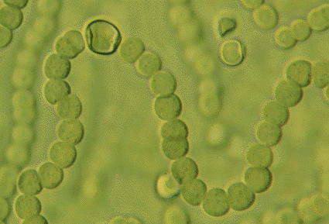
Notes:
Examples of heterocysts.

Slide 25
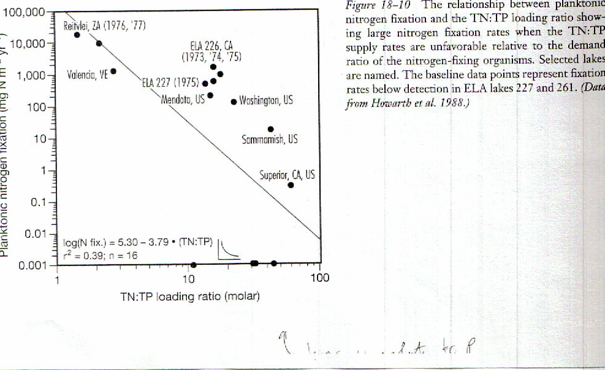
Nitrogen fixation
**Gives advantage to
Cyanobacteria = favored at low
N:P ratios
High N relative to P
Low N relative to P
Notes:
(there is a lot of P relative to N) related to amount of N available.
Gives competitive advantage to species that can “manufacture” their own supply
Cyanobacteria can also store excess phosphorus as polyphosphate giving them an even larger advantage
Cyanobacteria then do well when N:P ratios are low. Important hypothesis.

Slide 26
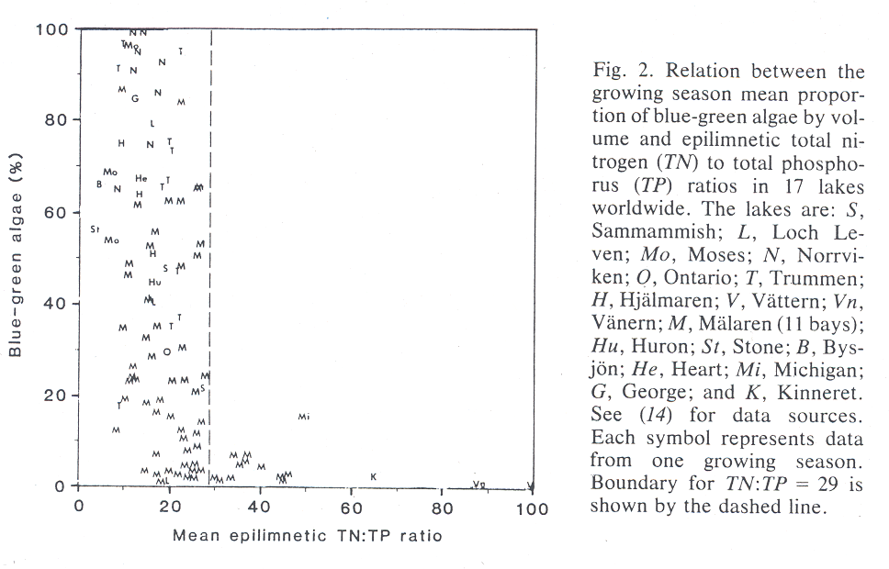
N:P Ratio and Cyanobacterial Dominance
The proportion of bluegreen algae in 17 lakes was low
when TN:TP exceeds 29:1, but could be high when
the TN:TP ratio is below 29:1
Smith, 1988
Notes:
Removal of N and not P would be counter productive because it would lower the N:P ratio and encourage BG’s
Nitrogen fertilization might lower the abundance of BG’s because it would raise the N:P ratio – add nitrogen might be a good strategy

Slide 27
Sources
1. Atmospheric deposition
2. Stream and river inflows
- Natural and anthropogenic
3. Groundwater
4. N fixation - bacteria and blue-green algae
5. Waterfowl
Allochthonous versus autochthonous?
Notes:
These include both allochthonous and autochthonous sources
Remember P: 10 - 50 μg/L typical range
Look at the range here = up to 3000 ug.L
Automobile exhaust, fossil fuel combustion…

Slide 28
Review Question
You want to determine the limiting nutrient of Grand Lake.
How would you do this?

Slide 29
Review Question
You are studying an Oklahoma reservoir that has been experience nuisance algal blooms.
You want to determine what nutrient is limiting, but you only know how much N and P are in the water.
  TN:TP = 55:1
What nutrient would you guess is limiting?
Notes:
Lots of n relative to P = P limited!
5:1 = still more N, but not nearly as much relative to what it needs. N limited because so much phosphorus.

Slide 30
Oligotrophic vs. Eutrophic
Feature | Oligotrophic | Eutrophic
Nutrient Level | Low | High
Phytoplankton Levels | Low | High
Oxygen Levels | High | Low
Water clarity | Very Clear | Very Turbid
Light Penetration | Good | Poor
Notes:
Where does oxygen come from? How does it get in a lake or reservoir?

Slide 31
“a skilled limnologist can probably learn more about the nature of a lake (or river) from a series of oxygen determinations than from any other kind of chemical data. “
Hutchinson, 1957
Notes:
DO is one of the most, if not the most important variable that you can measure.
You can tell a lot from a system based on its oxygen concentrations – an more importantly how oxygen varies spatially in a system. At the end of this lecture you will be able to make some predictions about a system based on its oxygen profile.
We all measure it.

Slide 32
What does DO tell us?
Ecological
  Health of a system
  Productivity
  Distribution of organisms
Chemical
  Solubility of ions
Physical
  Internal mixing patterns/thermocline
Notes:
Why do we care about DO –
About the ecological health of a system. Next slide.
Chemical effects – oxygen regulates the oxidation state and hence the solubility of many ions. Helps to determine the biological availability of many metals and nutrients. For example, under anoxic conditions (no oxygen) sediments release nutrients. Specifically, as the water above the sediment becomes anoxic the redox-potential at the water-sediment surface is reduced and iron (Fe) (III) is converted into Fe (II) resulting in a release of dissolved phosphorus (PO43-) back into the water column (Bostrom et al., 1988).
We will talk more about this when we talk about nutrient cycling!
Oxidation - the process of adding oxygen to a substance, or losing hydrogen atoms or electrons.
Reduction - the process of losing oxygen, or gaining hydrogen atoms or electrons

Slide 33
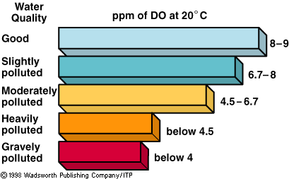

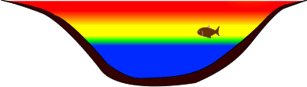
Notes:
Oxygen concentrations – certain species have oxygen requirements – how about fish; this is a general example, not sure this is exactly true;
Oxygen production is directly related to algal production – indicate high algae production; or productive system overall.
Potential habitat for fish or other organisms: Mid-summer, when strong thermal stratification develops in a lake, may be a very hard time for fish. Water near the surface of the lake - the epilimnion - is too warm for them, while the water near the bottom - the hypolimnion - has too little oxygen. Anoxia forces the fish to spend more time higher in the water column where the warmer water is suboptimal for them. This may also expose them to higher predation, particularly when they are younger and smaller.
(From: http://waterontheweb.org/under/waterquality/oxygen.html)
Some fish cannot survive less than 2 mg/L; however, this is somewhat seasonal as northern fish can not tolerate 3.5 mg/l at 20C; however, could tolerate in the winter because they have a slower metabolic rate in colder temperatures.

Slide 34
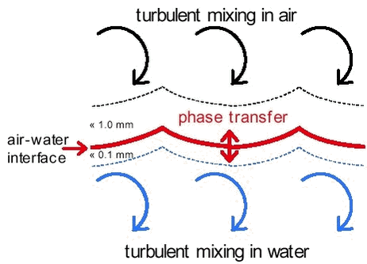
Where does DO come from?
Surface Aeration/Diffusion
Wind and Turbulence
O₂
Notes:
Two major sources of oxygen to aquatic ecosystems and they both near the surface; in a general sense the hypolimnion has no direct access to oxygen – remember why mixing from internal seiches is important – potentially moves oxygen into the hypolimnion through entrainment.
Surface aeration that is limited to the air-water interface; oxygen diffuses between lake and atmosphere, in either direction following a gradient of low to high concentration. If you have a lot of oxygen in a lake, there could be an actual diffusion gradient taking oxygen out of the environment.
Very slow process by itself – can take years for O2 to reach a depth of 5 m by molecular diffusion along; surface films can slow diffusion down
This process is enhanced by wind and turbulence – helps move O2 to lower layers; winds maintain a high O2 level above the interface; while turbulence maintains a low O2 below the interface. Together these processes help to maintain a steep gradient. Wind brings O2 to interface; turbulence moves it downward
These two mechanisms are very important for smaller stream systems, which often have high DO levels. Flowing water…
Surface films will slow it down: slows down diffusion – wetlands or standing water covered with leaves, scum, etc.

Slide 35
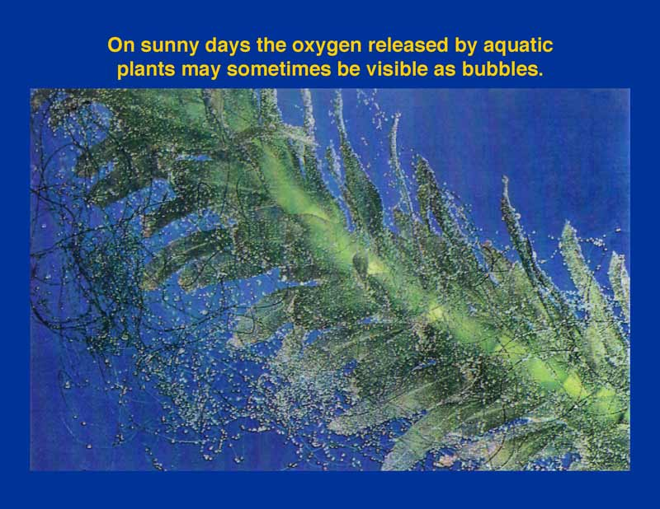
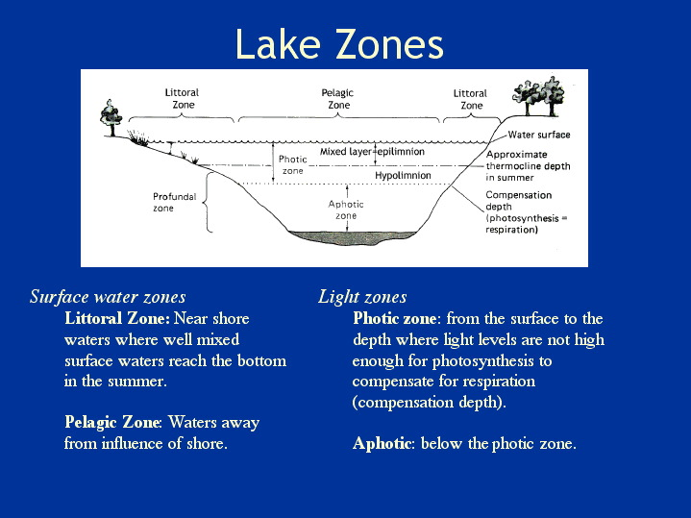
Biological Activities: Photosynthesis in Euphotic Zone
6CO₂ + 12H₂O →C₆H₁₂O₆ + 6O₂ + 6H₂O
Notes:
Photosynthesis by algae, macrophytes, or benthic algae adds DO to the euphotic zone according to this simplified formula that we have all seen before.
Remember we defined the photic zone as down to the 1% light level; also remember that we said that algae do not like the highest light levels; talk more about this later.
carbon dioxide + water + light energy → glucose + oxygen + water
Primary source of O2 lacustrine (lake like) systems. In most lakes, phytoplankton in open water; macrophytes in shallower lakes, littoral zones and ponds;
Smaller streams – maybe periphyton, although atmospheric is also important.

Slide 36
Algae in a Lake/Reservoir – oligotrophic and eutrophic
Oxygen Conc.
Midnight
Noon
Midnight
Notes:
Draw this for both oligotrophic and eutrophic lake
In a eutrophic pond, what can cause oxygen to decrease?

Slide 37
Algae in a Lake/Reservoir – oligotrophic and eutrophic
Oxygen Conc.
Midnight
Noon
Midnight
Notes:
Draw this for both oligotrophic and eutrophic lake
What are the process that cause this to drop in the absence of light?
Test question: Respiration – animals are using Oxygen at a faster rate than it is being produced by algae because there is no light (energy) for the algae to produce carbon.
Decomposition – bacteria use oxygen when they respire and decompose materials in the water.
Photosynthesis, respiration, exchange
Respiration, exchange

Slide 38
Temp / Oxygen (mg/L)
Depth (z, m)
Notes:
Draw this for both oligotrophic and eutrophic lake

Slide 39
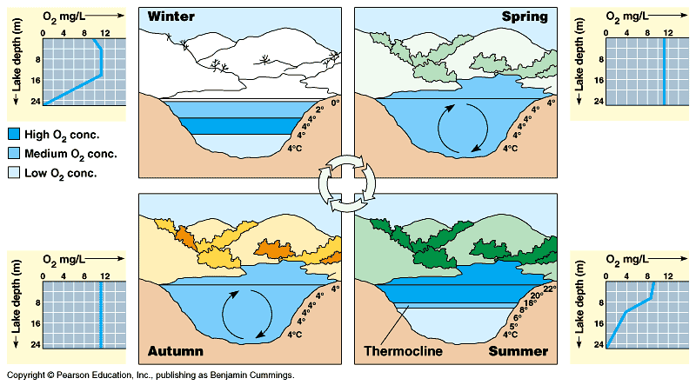

Slide 40
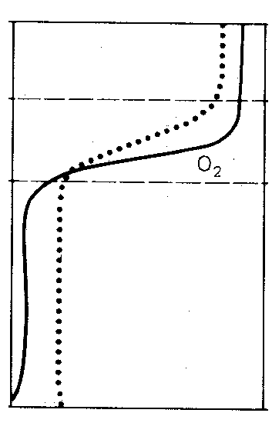
Oxygen Depth Profile in Stratified, Eutrophic Lake
Dissolved oxygen (mg/l)
Depth, z (m)
Notes:
High at the top. Low at the bottom
Cold water holds more oxygen than warm water

Slide 41
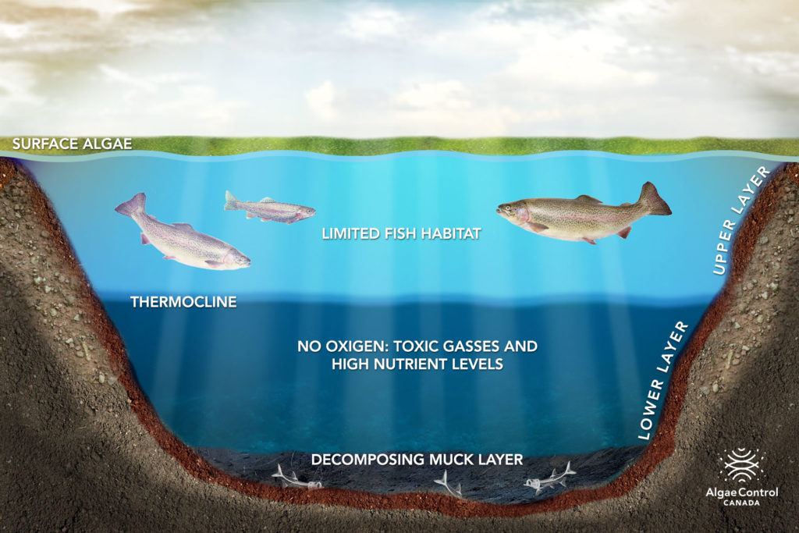
What happens when this turns over?

Slide 42
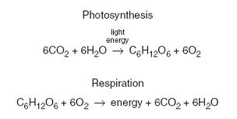
In the Hypolimnion…

Slide 43
What is BOD?
Notes:
We talk about oxygen use or loss in the hypolimnion – we can measure this with BOD.
Biochemical Oxygen Demand or Biological Oxygen Demand (BOD) is a chemical procedure for determining how fast biological organisms use up oxygen in a body of water. It is used in water quality management and assessment, ecology and environmental science. BOD is not an accurate quantitative test, although it could be considered as an indication of the quality of a water source.
BOD can be used as a gauge of the effectiveness of wastewater treatment plants. It is listed as a conventional pollutant in the U.S. Clean Water Act.
Most pristine rivers will have a 5-day BOD below 1 . Moderately polluted rivers may have a BOD value in the range of 2 to 8 mg/L. Municipal sewage that is efficiently treated by a three stage process would have a value of about 20 mg/L or less. Untreated sewage varies, but averages around 600 mg/L in Europe and as low as 200 mg/L in the U.S., or where there is severe groundwater or surface water infiltration. (The generally lower values in the U.S. derive from the much greater water use per capita than other parts of the world.)
BOD measures the rate of oxygen uptake by micro-organisms in a sample of water at a temperature of 20°C and over an elapsed period of five days in the dark.
There are two recognized methods for the measurement of BOD.

Slide 44
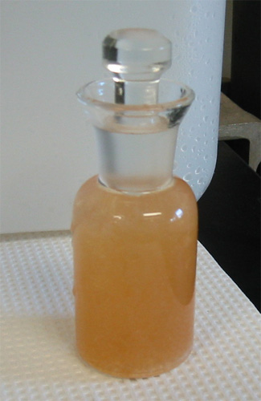
Biological Oxygen Demand
Notes:
Biochemical oxygen demand or BOD is a chemical procedure for determining the amount of dissolved oxygen needed by aerobic biological organisms in a body of water to break down organic material present in a given water sample at certain temperature over a specific time period. It is not a precise quantitative test, although it is widely used as an indication of the organic quality of water.^{[1]} It is most commonly expressed in milligrams of oxygen consumed per litre of sample during 5 days of incubation at 20 °C and is often used as a robust surrogate of the degree of organic pollution of water.
BOD can be used as a gauge of the effectiveness of wastewater treatment plants. It is listed as a conventional pollutant in the U.S. Clean Water Act.

Slide 45
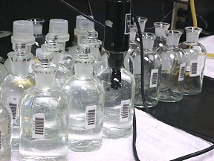
BOD: Biological oxygen demand
BOD Level (in ppm) | Water Quality
1 - 2 | Very Good There will not be much organic waste present in the water supply.
3 - 5 | Fair: Moderately Clean
6 - 9 | Poor: Somewhat Polluted Usually indicates organic matter is present and bacteria are decomposing this waste.
100 or greater | Very Poor: Very Polluted Contains organic waste.
Notes:
We talk about oxygen use or loss in the hypolimnion – we can measure this with BOD.
Biochemical Oxygen Demand or Biological Oxygen Demand (BOD) is a chemical procedure for determining how fast biological organisms use up oxygen in a body of water. It is used in water quality management and assessment, ecology and environmental science. BOD is not an accurate quantitative test, although it could be considered as an indication of the quality of a water source.
BOD can be used as a gauge of the effectiveness of wastewater treatment plants. It is listed as a conventional pollutant in the U.S. Clean Water Act.
Most pristine rivers will have a 5-day BOD below 1 . Moderately polluted rivers may have a BOD value in the range of 2 to 8 mg/L. Municipal sewage that is efficiently treated by a three stage process would have a value of about 20 mg/L or less. Untreated sewage varies, but averages around 600 mg/L in Europe and as low as 200 mg/L in the U.S., or where there is severe groundwater or surface water infiltration. (The generally lower values in the U.S. derive from the much greater water use per capita than other parts of the world.)
BOD measures the rate of oxygen uptake by micro-organisms in a sample of water at a temperature of 20°C and over an elapsed period of five days in the dark.
There are two recognized methods for the measurement of BOD.

Slide 46
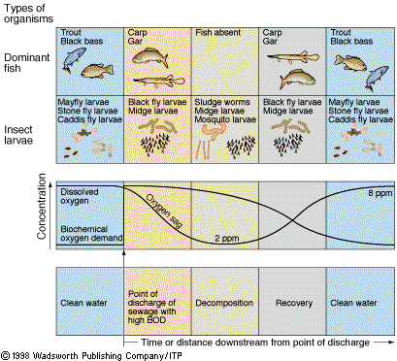
BOD in Flowing Water
Notes:
Remember BOD – uses the special BOD bottles, usually take a sample put it in a bottle for 5 days and see how much oxygen is used over this time; if there is a lot of organic mater this value will be higher. Usually at 20degC.
Look at this in streams. This is kind of a classic figure. Types of organisms, oxygen concentrations; down stream from a source of pollution.

Slide 47
Temperature profiles in an oligotrophic and eutrophic lake in the late summer?
Temperature (deg C)
Depth (z, m)

Slide 48
Temperature profiles in an oligotrophic and eutrophic lake in the late summer?
Temperature (deg C)
Depth (z, m)

Slide 49
Oxygen Profiles in an Oligotrophic and Eutrophic Lake in the late summer
Dissolved Oxygen (mg/L)
Depth (z, m)
Notes:
Draw this for both oligotrophic and eutrophic lake

Slide 50
Oxygen Profiles in an Oligotrophic and Eutrophic Lake in the late summer
Dissolved Oxygen (mg/L)
Depth (z, m)
Notes:
Draw this for both oligotrophic and eutrophic lake

Slide 51
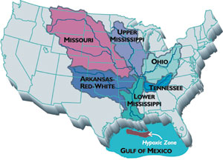
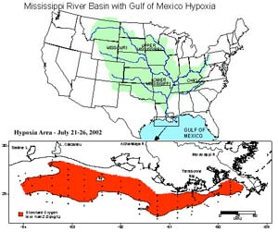
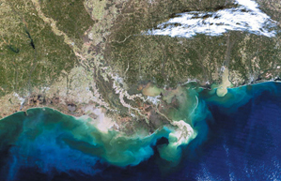
Notes:
Just showing the deadzone in the Gulf of Mexico. N limited salt water is pounded by N rich runoff from the corn-belt.

Slide 52
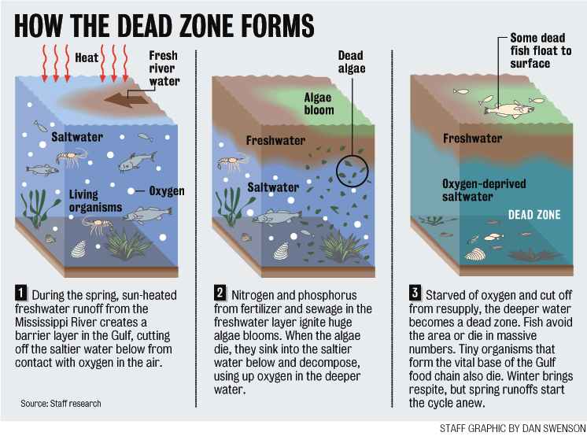
Notes:
I typically mention “dead zones”. We have time, but I or we can do it after the exam as well as a way to review the topics.

Slide 53
Dead Zone
How many areas like this are around the world?
What type of systems are prone to hypoxia?
What is the cure?
Notes:
Stagnant, stratified – anytime there is water that is cut off from the atmosphere…
What else is in the input – a lot of suspended sediment – material for bacteria to break down = respiration!
Low physical energy
Freshwater input
High nutrient input

Slide 54
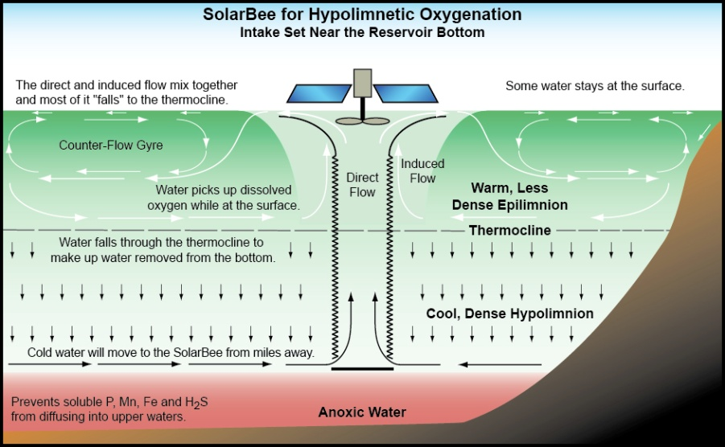
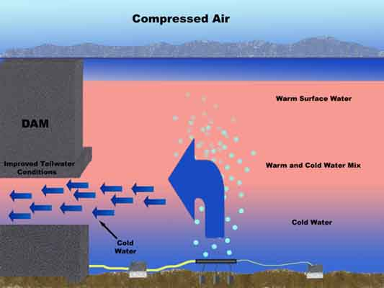
Break Stratification
Physically mix a lake
Hypolimnetic withdrawal
Notes:
(Mechanical, bubble oxygen)
Involves disrupting stratification or preventing stratification using pumps and compressed air
The technique is accomplished by installing a pipe along the lake bottom from near the deepest point to the outlet

Slide 55
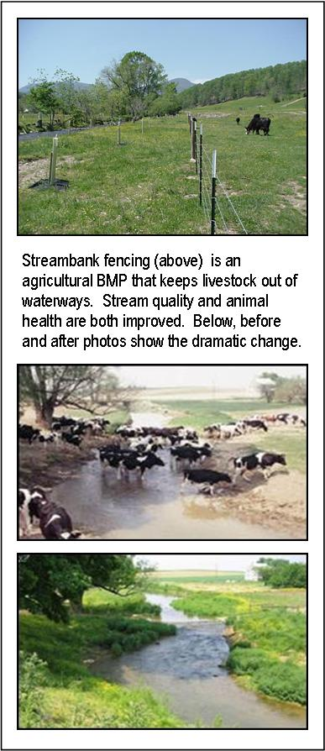
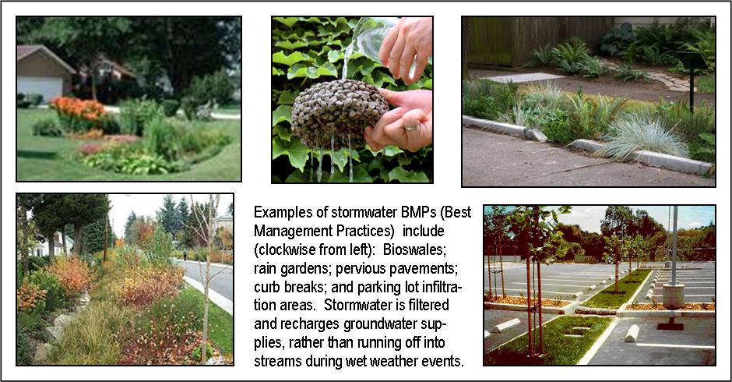
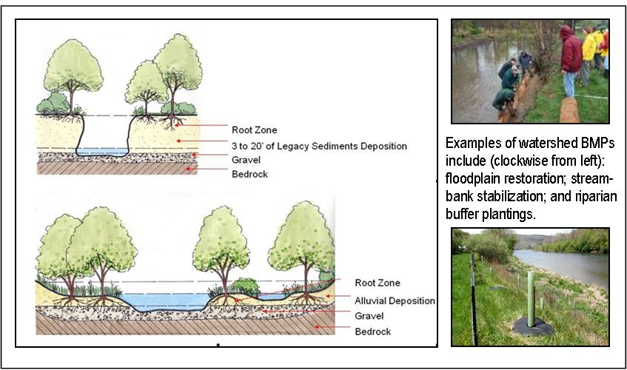
Better Management
BMP’s
Notes:
Methods or techniques found to be the most effective and practical means in achieving an objective (such as preventing or minimizing pollution) while making the optimum use of the firm's resources.
implementing the CWA, the U.S. Environmental Protection Agency (EPA) defined BMP in the federal wastewater permit regulations, initially to refer to auxiliary procedures for industrial wastewater controls.
...schedules of activities, prohibitions of practices, maintenance procedures, and other management practices to prevent or reduce the pollution of waters of the United States, BMPs also include treatment requirements, operating procedures, and practices to control plant site runoff, spillage or leaks, sludge or waste disposal, or drainage from raw material storage.^{[6]} Later the Agency added a reference to stormwater management BMPs.
...each NPDES permit shall include conditions meeting the following requirements when applicable... (k) Best management practices (BMPs) to control or abate the discharge of pollutants when: ... (2) Authorized under section 402(p) of the CWA for the control of storm water discharges...^{[7]}

Slide 56
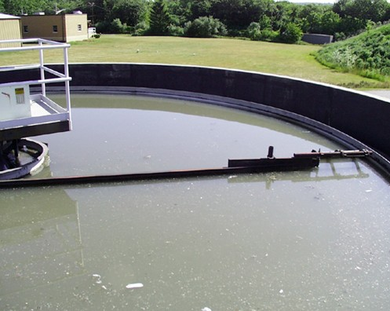
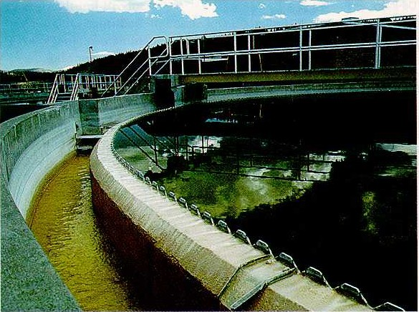
Waste Water Teatment:
Primary Treatment
Objective
  POM removal
Settling Process
  Water
  Sludge
Notes:
removal of particulate organic material (POM)
*this reduces BOD (and nutrients)
Gravity! Waste flow and turbulence is reduced and the waste water is detained long enough for settleable solids to collect at the bottom.
Removes about 35% of BOD – in primary treatment
primary clarifiers have low flow (2 m/hour)
*particles settle to bottom
*clarified water flows over the sides
*solids (=raw sludge) are sent to sludge facility (more later)
*clarified water sent to secondary treatment
Often lined with a cloth – water is pushed through the cloth with vacuum filtration – the solids that accumulate on the cloth can be dried and scrapped.

Slide 57
Secondary Treatment
Objective
  DOM removal
Aerobic biological process
  1. Trickling Filter
  2. Activated Sludge
Notes:
removal of dissolved organic material
*this further reduces the BOD (and nutrients
2° treatment is at least partly a biological process
*aerobic bacteria respire DOM and convert it to CO2 and H2O
*C6H12O6 + O2 ➔ CO2 + H2O
*reduces the BOD in the STP instead of the receiving water
Bacteria use oxygen when they decompose – therefore, make sure that there is enough oxygen, add bacteria and let it break it down!

Slide 58
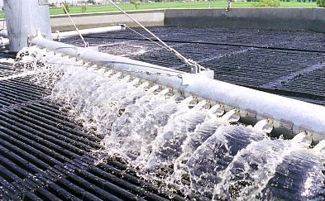
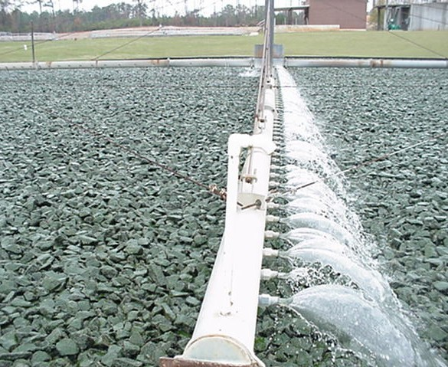
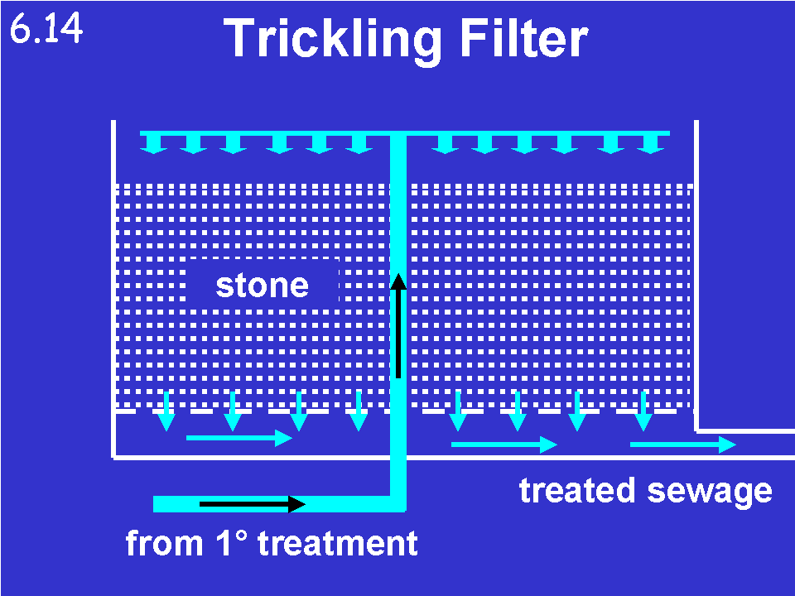
Trickling Filter
Notes:
a. Trickling Filters
*the oldest of the methodologies
*large tanks filled with a substrate (medium) that provides abundant surface area exposed to air (oxygen)
*medium may be rocks or synthetic
**Can filter through several times – different loops
supernatant from primary clarifiers is applied to the media and allowed to flow over its surfaces
*bacteria growing on the surfaces respire the DOM
*biological community with several trophic levels
*bacteria are the base of the food web
*no producers; the energy supply is allochthonous (it is DOM from your home)
*bacteria, protozoa, rotifers, insect larvae
insect larvae include rat-tail maggots, filter flies, horseflies
*these do not contribute importantly to respiration but can be a nuisance
*filters are periodically flooded to kill insect larvae
*trickling filter ecosystem lacks producers
*relies on allochthonous production (BOD)
*there is a little photosynthesis on the surface layer of rocks (negligible)
*trickling filters can achieve 85-90% BOD removal

Slide 59
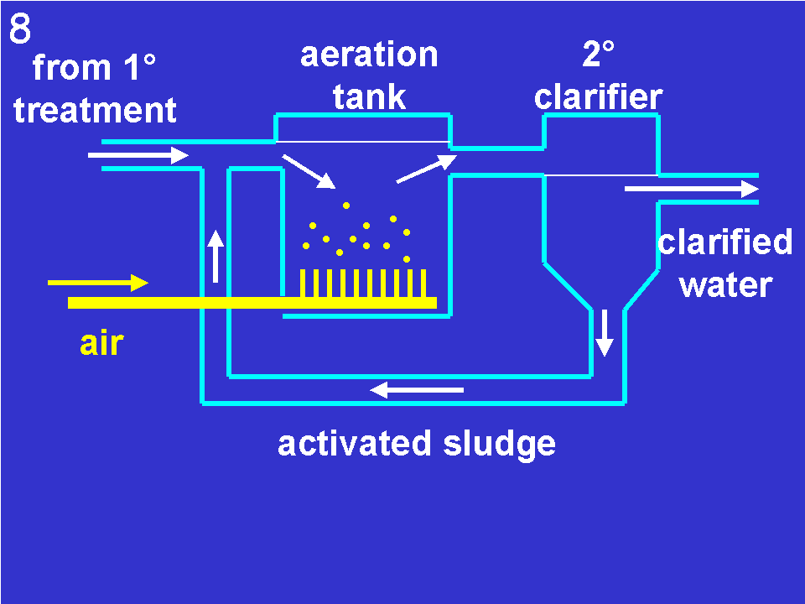
Activated Sludge…more later
Notes:
the most widely used system
*more complex, more expensive
*but requires less space
*a little more effective
Clarified stream from the primary settling basin is mixed with a suspension of living and active (activated) micro-organisms, protists, and metazoans in an aerated tank. The Dissolve organic matter acts as a nutrient source for the growth and reproduction of the activated sludge population. The DOM is removed from the water (becomes part of the sludge). The solids are able to settle out in the thickening tanks, the upper clarified liquid being sent on for tertiary treatment (if present).
Can take many forms – it might go back through several times. Can be replicated several times.
employs a large tank through which clarified sewage flows
*clarified wastewater enters one end
*inoculated with aerobic heterotrophic bacteria (from sludge)
*vigorously aerated
*bacteria assimilate DOM and reproduce rapidly
*DOM thereby is converted to POM
*some is respired to CO2 and H2O
Pg (= DOM) = Pn (= POM) + R (= CO2 + H2O)
*effluent is sent to secondary clarifier to remove sludge (POM)
*the sludge is "activated" sludge
*some of it is used to inoculate the incoming supernatant
*2° supernatant goes to tertiary treatment or post-treatment
*excess sludge is wasted back to the sludge treatment facility (more later)
*activated sludge can remove 90-95% of DOM

Slide 60
Tertiary Treatment
Objective
  Remaining dissolved organics
  Dissolved inorganic matter
    Nutrients (N and P)
Chemical Process – P
Biological Process - N
Notes:
removal of dissolved inorganic material (DIM), nutrients
*especially phosphorus, sometimes nitrogen
chemical, physical, or biological
*no single, simple, inexpensive process
*usually expensive, unlike 1° and 2° treatment
most STPs do not have 3° treatment
*becoming more and more common as required by EPA and state regulators
*necessary to prevent eutrophication of receiving water

Slide 61
Nutrient Removal
P Removal
  Alum
  Precipitate settles, separated, sent to landfill
N Removal
  Ammonification
  Nitrification
  Denitrification
Notes:
aluminum sulfate, aluminum chloride, ferric chloride, or an organic polymer
*precipitate or coagulant is settled, separated, sent to landfill
Both can result in high removal rates…however…
*a biological process
*N has a gas phase (unlike phosphorus)
*relies on several species of nitrogen-metabolizing bacteria
*nitrogen, in various oxidation states, figures in the energy metabolism of many bacteria
*incorporated into special activated sludge tanks
*tank must be partitioned to maintain different oxygen regimes
*heterotrophic ammonifying bacteria mineralize organic nitrogen to ammonia under anaerobic conditions
*C-NH2 è NH4
*chemoautotrophic nitrifying bacteria convert NH4 to NO3 under aerobic conditions
*NH4 è NO3
*nitrifying bacteria use NH4 as an energy source
* anaerobic heterotrophic denitrifying bacteria
*use NO3 as an oxidizing agent to oxidize reduced carbon compounds for energy
*this reduces NO3 to N2
*NO3 è N2
*N2 released into atmosphere
What varies for these steps? Need oxygen for some, but not others. Have to partition tanks.

Slide 62
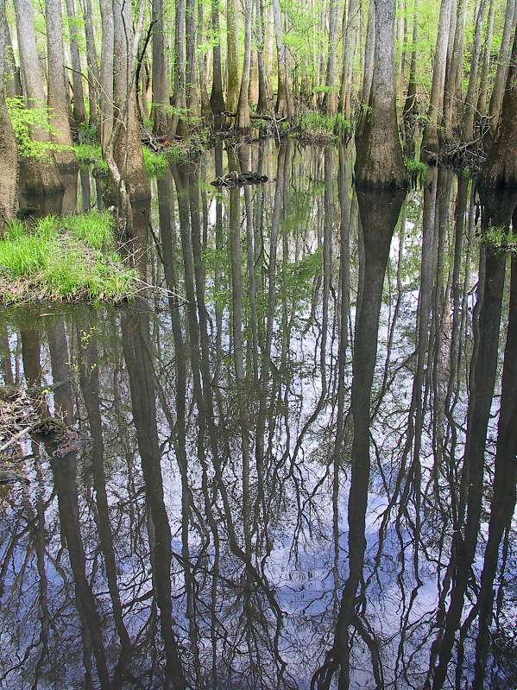
Nutrient Removal
Irrigation
Constructed wetlands
Example: A 1990 study showed that, without the Congaree Bottomland Hardwood Swamp in South Carolina, the area would need a $5 million waste water treatment plant.
Notes:
Irrigation
plants can be irrigated with treated wastewater
*St. Petersburg, FL irrigates 4000 acres of lawns, parks, golf courses with 2° effluent
*requires an expensive independent distribution system in addition to the potable water distribution system
Wetlands
effluent can be routed through a constructed wetland for natural nutrient removal
*Orlando, FL uses a 1200 acre constructed wetland
*>1,000,000 marsh plants planted in a maze of shallow ponds and marshes
*creates an attractive wildlife habitat
*Phinzy Swamp Nature Park in Augusta is a 1,150 acre constructed wetland
*provides final treatment for Augusta wastewater
Example from conbio lecture?

